Slide 1

Project Title -Netflix Dataset Analysis
[ Mushahid Raja ]
[: APPLY_175628452168aec669d4730 ]

Slide 2

PROBLEM STATEMENT
🧩 Problem Statement
Netflix is one of the world’s largest streaming platforms, offering both original and licensed content. However, with competition from Amazon Prime, Disney+, and regional OTTs, Netflix needs to understand its content patterns and trends.
👉 Main Problem: To analyze content trends (Movies vs. TV Shows, genres, and country contributions) and provide strategic recommendations on what types of content to focus on for future growth.

Slide 3
Project Description [write detail description about your project] 📘 Project Description The project involves analyzing Netflix’s dataset containing 7,789 records and 11 columns (covering 2008–2021). It explores: The distribution between Movies and TV Shows over the years Country-wise content contributions Genre popularity and changes over time The dataset includes details such as: Title, Director, Cast, Country, Release Date, Rating, Duration, and Type. This analysis helps identify which regions, genres, and formats dominate Netflix’s library, and how its strategy has evolved globally.

Slide 4

WHO ARE THE END USERS?
👥 End Users
Netflix Data Analysts – to identify trends and guide business decisions.
Marketing Teams – to target audiences by content type and region.
Producers and Content Creators – to understand what type of shows/movies are in demand.
OTT Researchers or Students – for studying global media consumption patterns.

Slide 5

Technology Used
Python – Core programming language
Pandas & NumPy – Data cleaning and preprocessing
Scikit-learn – Machine learning (model training, regression, evaluation)
Matplotlib/Seaborn – Data visualization and feature importance
Google Colab – Cloud-based environment for running the project
File handling libraries – openpyxl (for Excel) and built-in CSV handling

Slide 6
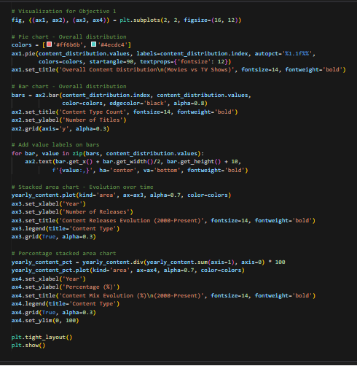
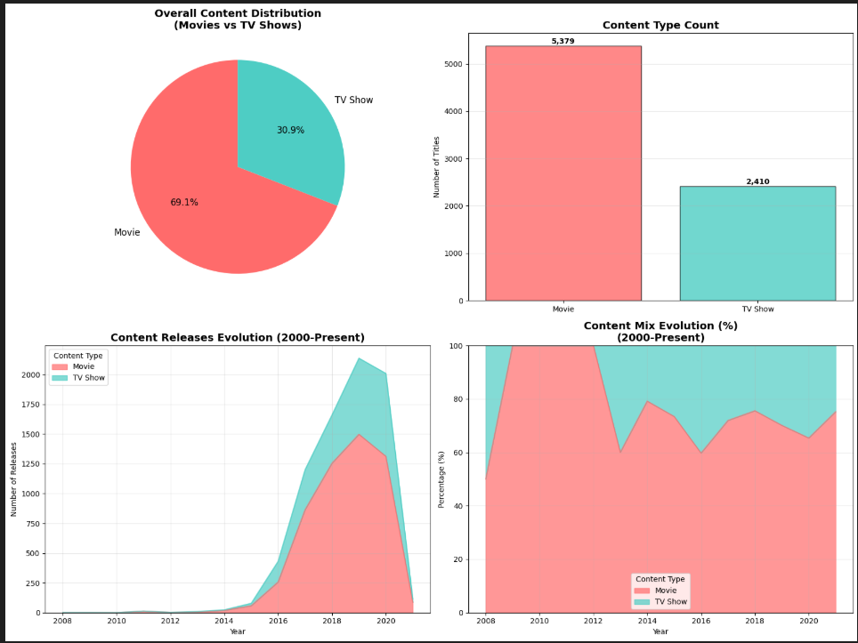
RESULTS1
[Add screen shots of your code or Chart(s) ]

Slide 7
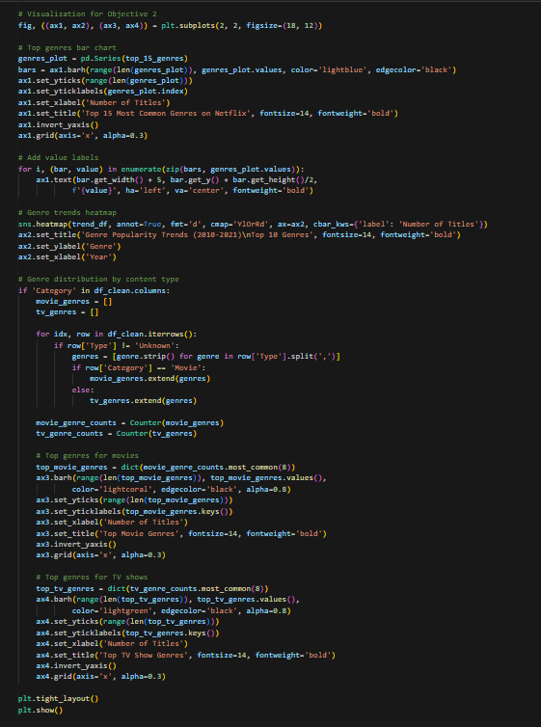
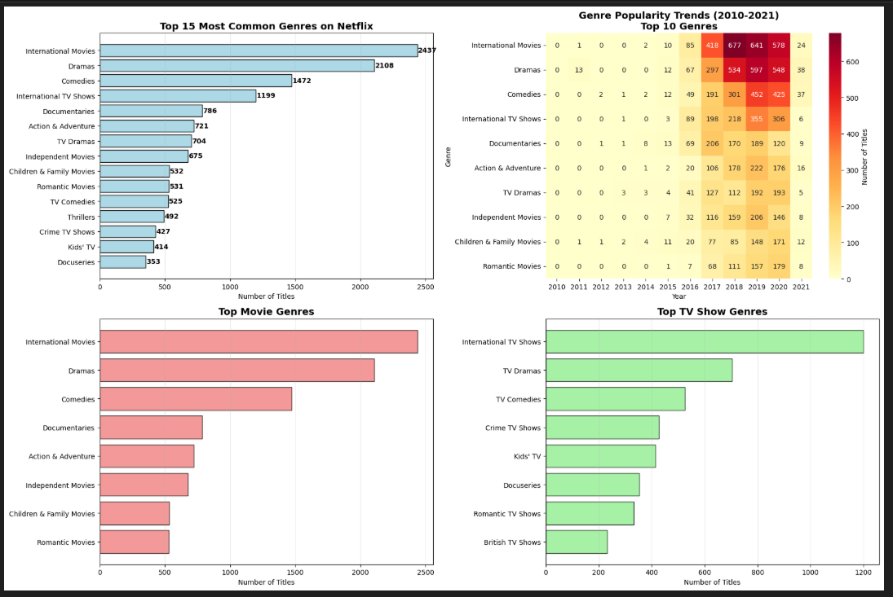
RESULTS2
[Add screen shots of your code or Chart(s) ]

Slide 8
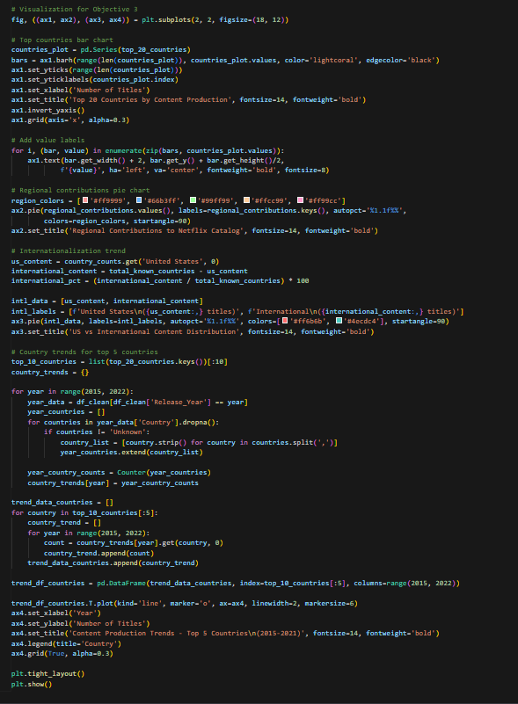
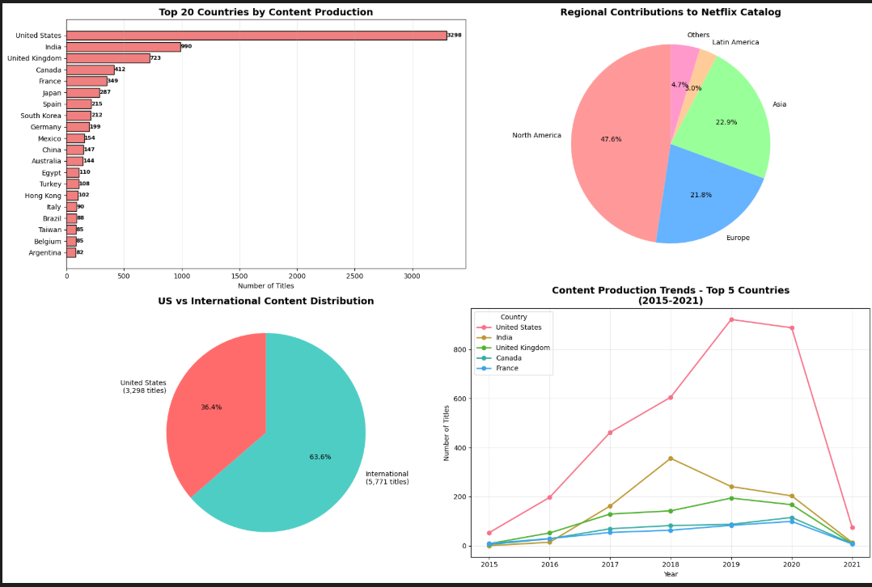
RESULTS3
[Add screen shots of your code or Chart(s) ]

Slide 9
GitHub repository
https://github.com/Mushahid0786/VOIS_AICTE_OCT2025_MajorProject_MushahidRaja.git

Slide 10

Getting started with Basics of Python Certificate
[Paste your Certificate Here]

Slide 11

Data Visualization Certificate
[Paste your Certificate Here]

Slide 12
Thank you
.
.

